Slide 1
GitHub
Daniel Ablog
November 20, 2014

Slide 2
Creating an Account and Downloading Desktop Client

Slide 3
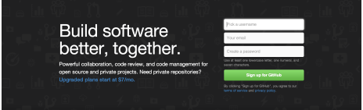
Creating An Account
Go to GitHub website: https://github.com
Sign up online via GitHub website with username, password, and email
(Optional) Useful link: https://help.github.com/articles/set-up-git/

Slide 4
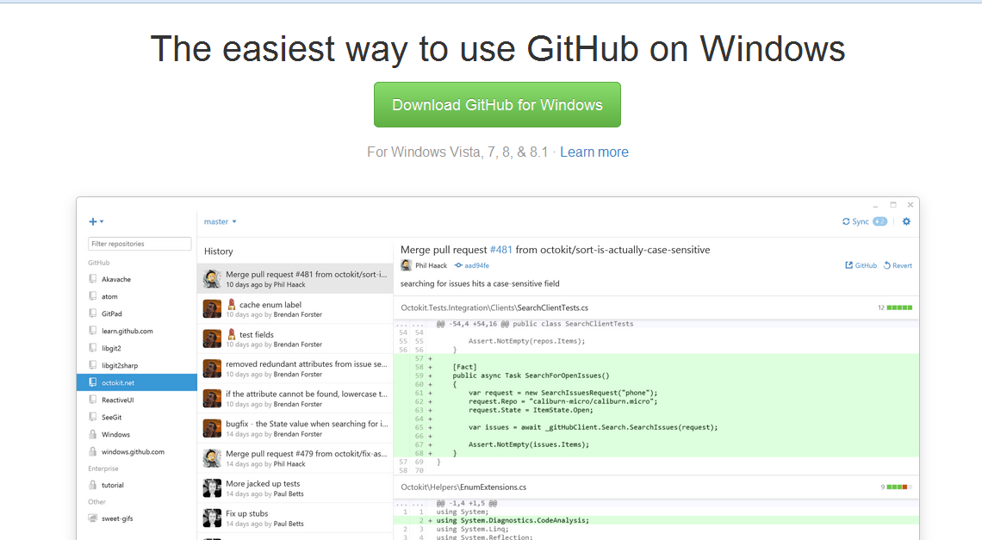
Download and Install GitHub Desktop Client
Go to GitHub website: https://github.com
Scroll down until you find the link for downloading “GitHub on Windows”.
Download and install GitHub Desktop. Note: You will install GitHub Desktop as well as Git Shell (command line)

Slide 5
Forking a Repository

Slide 6
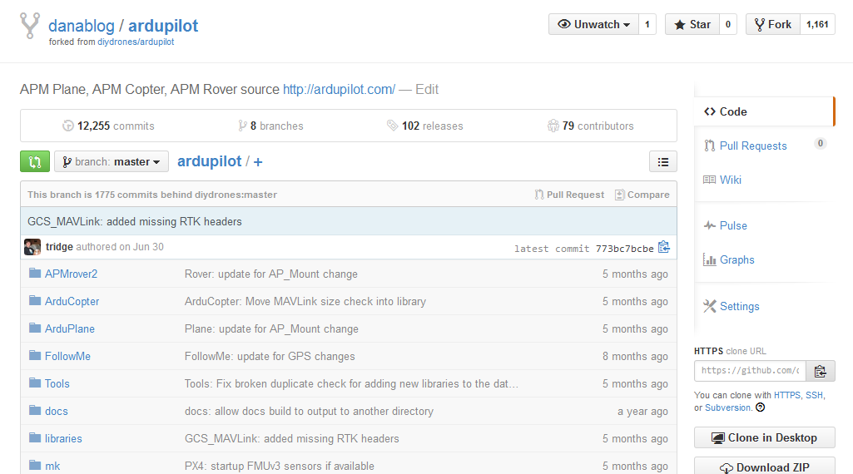
Forking a Repository Steps
Login to your personal online GitHub account.
Access the original master repository in online GitHub that you want to fork.
Click on “Fork” to perform the desired task to your personal account.
You have now created your own forked copy of the repository. The authors and contributors from the original repo will not see your changes.
To fork a copy of the repository to your personal account

Slide 7
Cloning a Forked Repository for Local Desktop Use

Slide 8
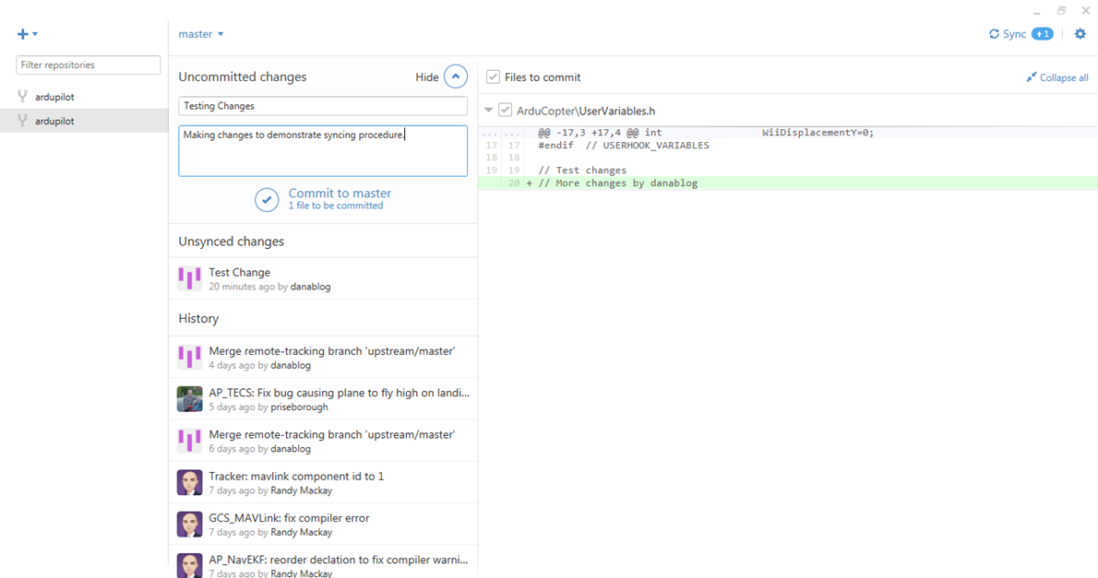
Clone Forked Repository
Ask Dr. Chris Lum to add you as a “Collaborator” to the UWAFSL repo.
Login to your GitHub Desktop local client.
Verify that the forked repository that you want to clone to your desktop is available. Note: If you were added as a “Collaborator” to UWAFSL by Dr. Chris Lum, you should see it on the left side of the GitHub Desktop client.
Forked Repository

Slide 9
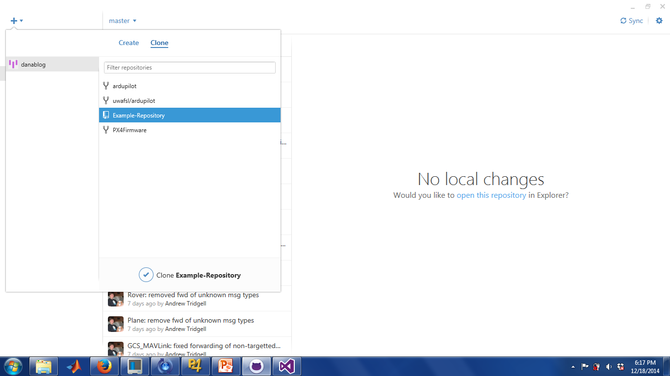
Clone Forked Repository
Click on the plus sign at the top left corner.
Click on the “Clone” tab. Note: Your forked repository should be available in the list.
Click on your desired repository that you want to clone and click on the check mark on the bottom.
You have now created a desktop copy of the UWAFSL repo that you can make changes to!
To clone to desktop

Slide 10
Syncing a Local Clone to the Original Master Repository (Receive Updates/Bug Fixes from Original Repository, diydrones/arudpilot)

Slide 11
Basic Requirements
To contribute to a shared project and receive changes you must first:
Setup a GitHub account at https://github.com
Be added as a “collaborator” for the project by the “owner” or “author” of the forked repository (i.e. ask Dr. Chris Lum to be added to the project)
Know how to sync and upload changes to and from your local repository to the shared master repository (i.e. follow steps on the next few slides)

Slide 12
Set “Upstream” Remote Repository

Slide 13
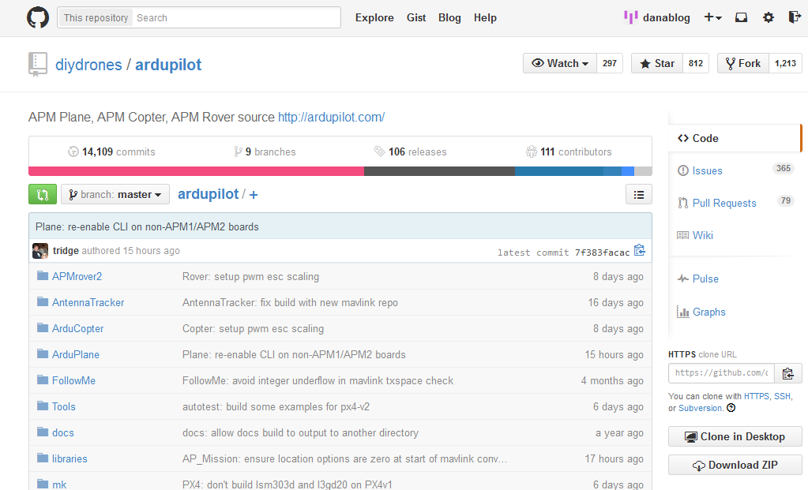
Set “Upstream” Remote Repo
Go to GitHub online and access the original “upstream” master repository (the repository that you originally forked from)
Copy the clone URL for the original repository
To copy URL

Slide 14
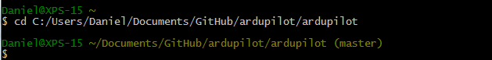
Set “Upstream” Remote Repo (cont.)
Open GitHub command line “GitShell” or “GitBash” application
Change working directory to location of local clone by typing: cd working_directory (working_directory is your current clone location). Make sure to use FORWARD SLASHES. In my case, it was: C:/Users/Daniel/Documents/GitHub/ardupilot/ardupilot
Should get this after changing working directory

Slide 15
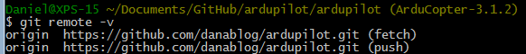
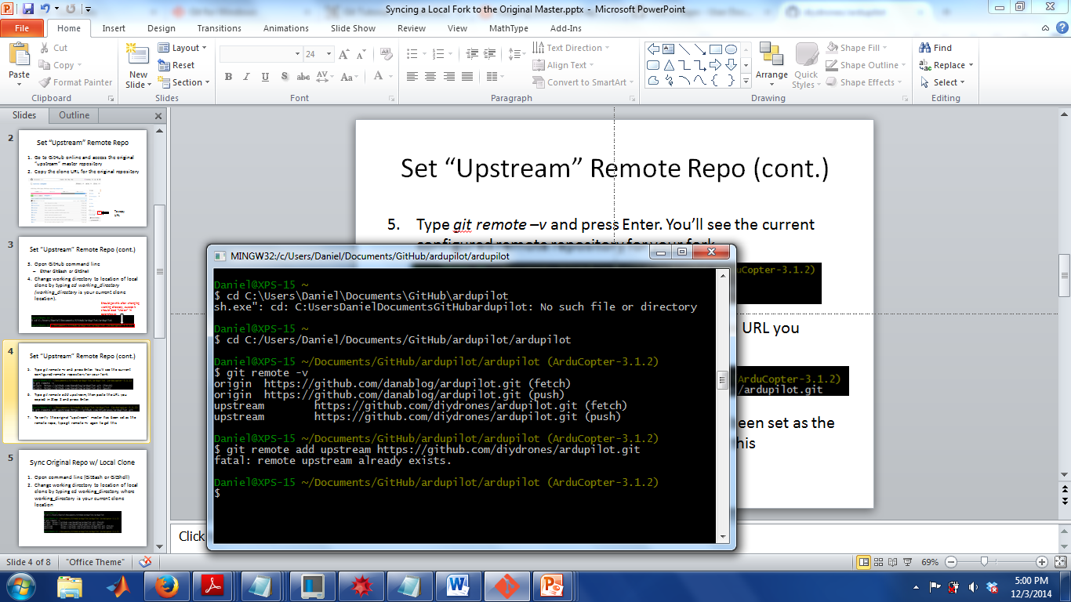
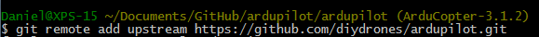
Set “Upstream” Remote Repo (cont.)
Type git remote –v and press Enter. You’ll see the current configured remote repository for your fork (top figure). Note: If upstream repository is already set, you will see (bottom figure). If https://github.com/diydrones/ardupilot.git is the upstream link, you do not need to do step 6. If not, move to step 6.
Type git remote add upstream, then paste the URL you copied in Step 2 and press Enter.

Slide 16
Syncing the Original Master Repository with your Local Desktop Clone (Receive Updates and Bug Fixes from diydrones/ardupilot)

Slide 17
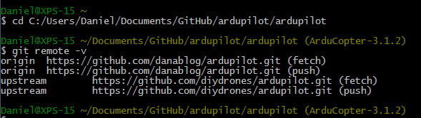
Sync Original Repo w/ Local Clone
Open command line (GitBash or GitShell)
Change working directory to location of local clone by typing command: cd C:/Working_Directory, where Working_Directory is your current clone location. Make sure to use FORWARD SLASHES. For example, in my case, it was: C:/Users/Daniel/Documents/GitHub/ardupilot/ardupilot

Slide 18
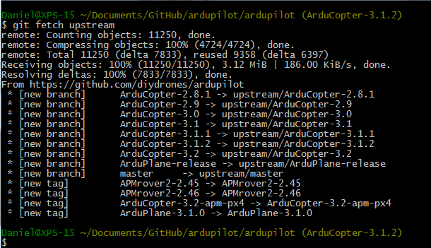
Sync Original Repo w/ Local Clone (cont.)
Fetch the branches and their respective commits from the upstream repository by using the command: git fetch upstream

Slide 19
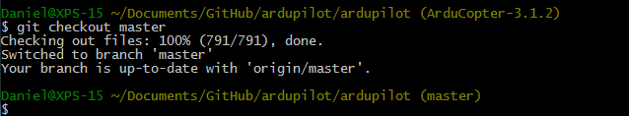
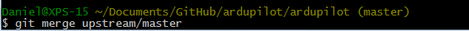
Sync Original Repo w/ Local Clone (cont.)
“Check out” your fork’s local master branch using the command: git checkout master
Merge changes from “upstream” original master branch to your local master branch using command: git merge upstream/master
All commits and updates from the original “upstream” master repository have been added to your local clone.

Slide 20
Making Changes in Local Desktop Cloned Repository

Slide 21
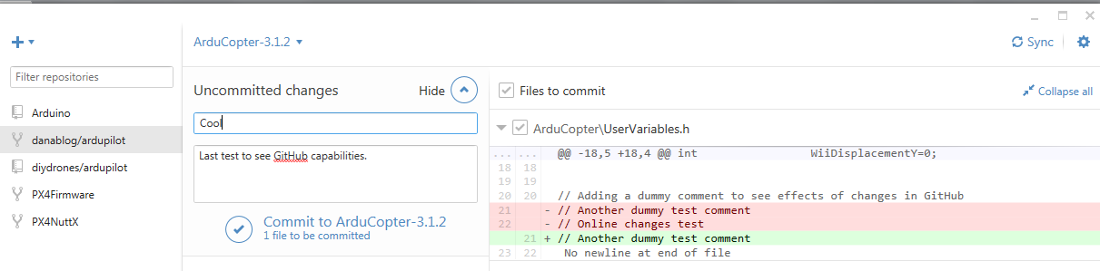
Making Changes in Desktop Repository (Cont.)
Locate desired file in “cloned” location in Windows Explorer and edit file.
After editing, GitHub/GitHub Desktop notices any changes made to the local file and previews the changes in the local client.
Now you must push changes to UWAFSL repository (i.e. follow steps on next slides)
GitHub Desktop tracks changes

Slide 22
Push Local Changes to UWAFSL Forked Master Repository

Slide 23
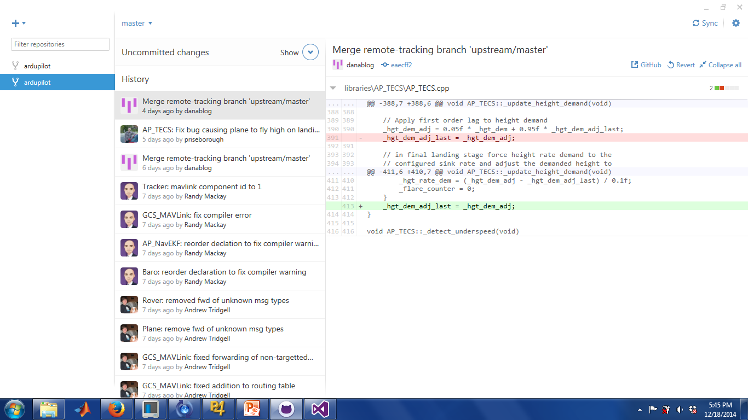
Sync UWAFSL Forked Repo w/ Local Clone Changes
After making changes, open the GitHub Desktop local client. (Should see “Uncommited Changes” above “History”)
Click on the arrow for “Show” to show the uncommitted change

Slide 24
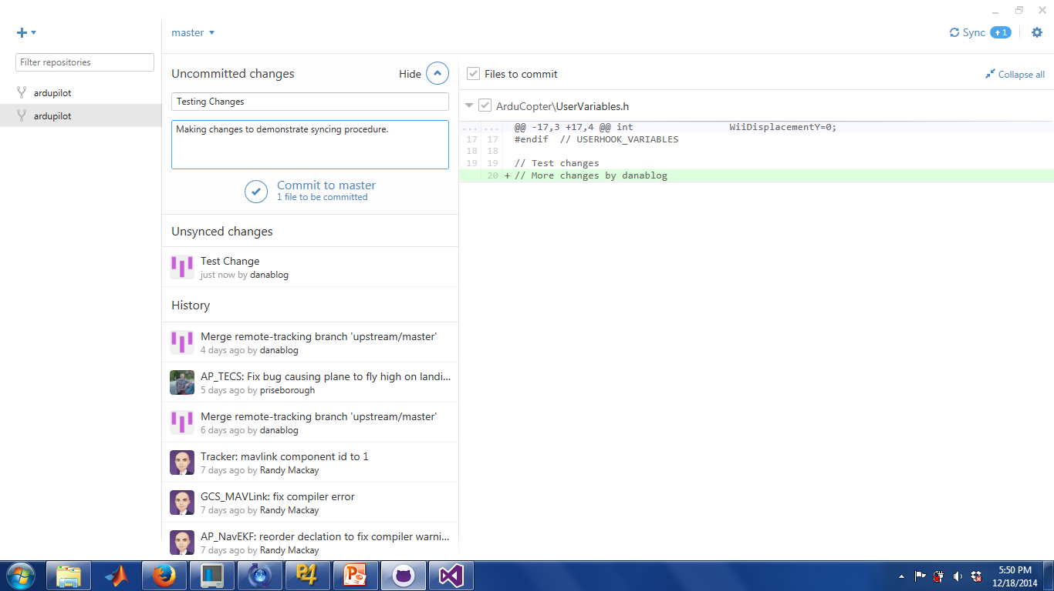
Sync UWAFSL Forked Repo w/ Local Clone Changes
Write a summary and description of your changes.
Click on “Commit to master” checkmark under “Description”

Slide 25

Sync UWAFSL Forked Repo w/ Local Clone Changes
Click on “Sync” at the top right corner to push changes to the UWAFSL Forked Master Repository. Note: should see +1 or +(number of changes) beside “Sync” if changes have been made. This occurs when a “Collaborator” makes a change. You are now done!

Slide 26
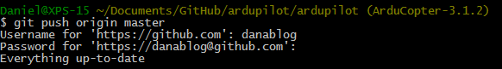
(Optional) Pushing Changes to Forked Repo via Command Line
An alternative way to push changes is by using the command line (either GitShell or GitBash). In the command line, type:
git push origin master
The online forked repository is now synced with your local clone and has received your changes.

Slide 27
(Optional Alternative) Making Changes in Online Repository

Slide 28
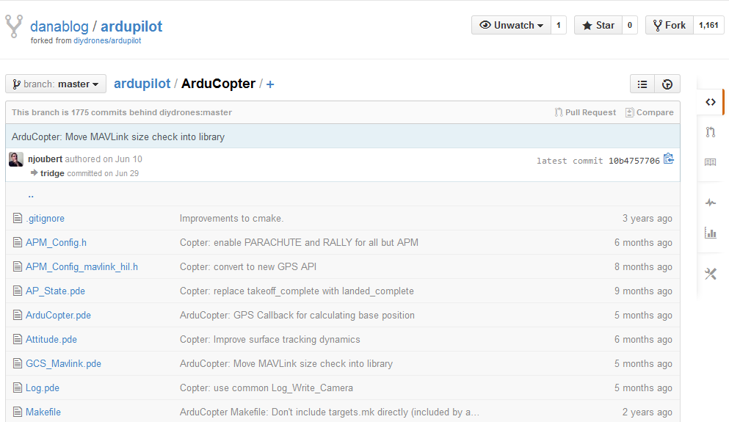
Making Changes in Online Repository
Set up a GitHub account.
“Fork” a branch of the master repository to your personal account.
To “fork” a repository

Slide 29
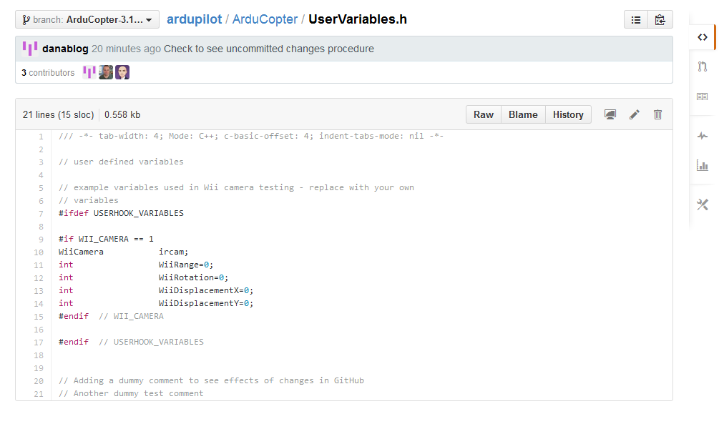
Making Changes in Online Repository (Cont.)
Locate desired file in your “forked” repository and edit file.
Click on the pencil to make changes

Slide 30
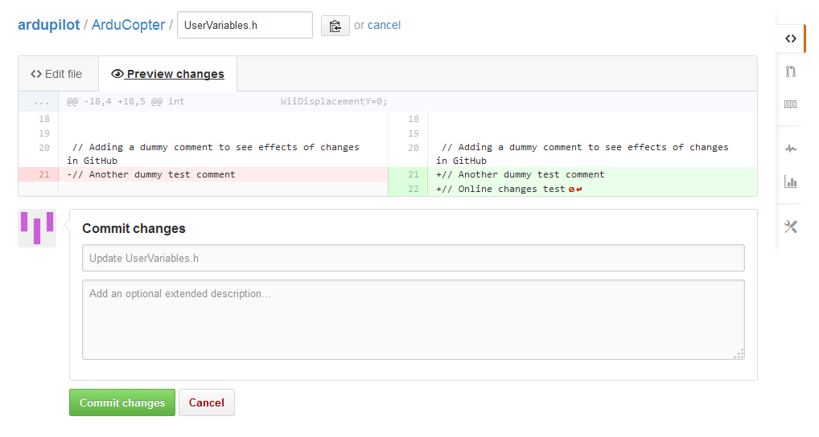
Making Changes in Online Repository (Cont.)
After editing, GitHub notices any changes made to the local file and allows you to preview the changes online.
Like Perforce, must provide a description to the changes made.
Click “commit” and the changes are then made.
Click this tab to preview changes
Add a description
Finalize change and commit

Slide 31
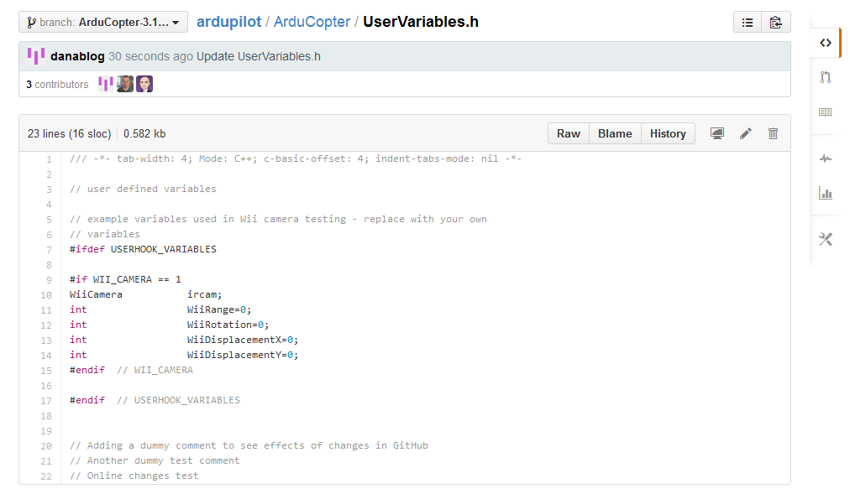
Making Changes in Online Repository (Cont.)
Now, changes are visible in online repository
Feedback can be given on change via GitHub
Useful link: https://help.github.com/articles/create-a-repo/

Slide 32
Informational Slides on GitHub

Slide 33
GitHub Main Functions
Acts as an online cloud where project/code files can be stored and updated by multiple users
Similar to Perforce,
Allows updating code from local desktop clients
Can download “clones” or zip files of the repositories from the master repository

Slide 34
What is a Repository?
A place where all files can be stored online (e.g. files dealing with coding, pictures, CAD, text, word, etc.). Kind of like a cloud.
Forum for developer/author comments.
Can be public or private based on settings.
If public, others can view files and fork your repository to their account and also desktop.
Allows cloning and downloading from personal account
Useful link: https://help.github.com/articles/create-a-repo/

Slide 35

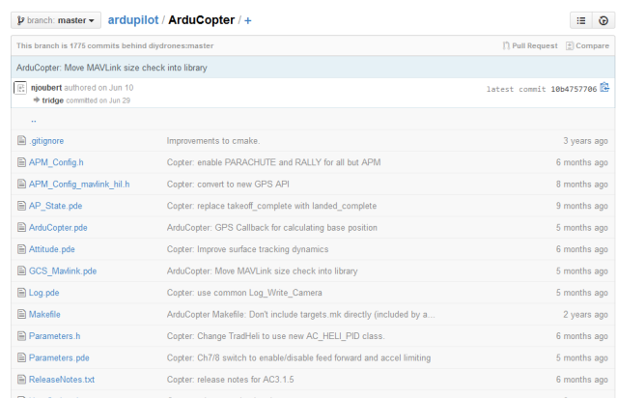
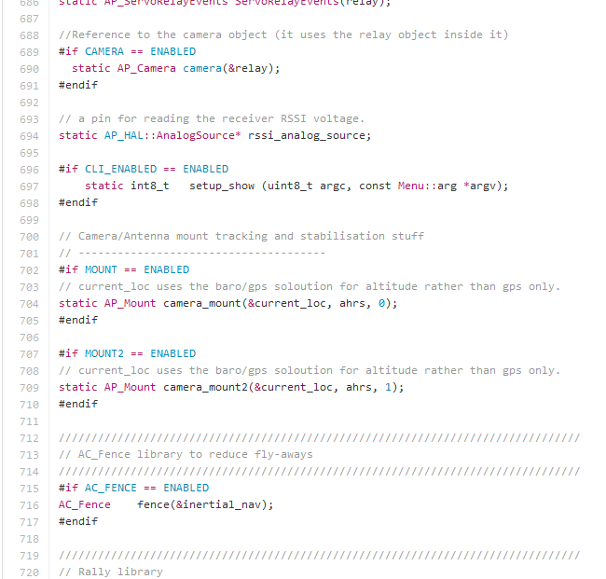
What is a Repository? (Cont.)
Contains projects and files associated
Can access all project files
Can view/alter code in online repository

Slide 36
GitHub vs. Perforce
GitHub | Perforce
Forking/cloning a repository | Adding a workspace on desktop
Commit changes | Mark for add
Pull Request | N/A
Sync files | Get latest revision
Revert | Revert/Revert if unchanged
Clone | Simultaneously checks out all files while making a desktop copy
Split | Diff Against

Slide 37
GitHub as a Replacement for Perforce?
Pros
Does not require a lot of space (Tbytes) as developers can have own copy of local repository.
Can work with files offline and save changes.
Open source. No licensing fees.
Cons
GitHub doesn’t have the visual GUI ease that Perforce has and the organization for adding/deleting files and tracking changes
GitHub doesn’t work well with large repository copies and binary files. Very slow.
GitHub is slow when syncing repositories because of overhead transfer of all files.
Conclusion
Works well with open source code (i.e. ArduPilot)
May not be a good replacement due to slow processing times for binary files

Slide 38
Sources
“GitHub Features”. Nov 20, 2014. GitHub Inc. 2014. https://github.com/features
“Version Control – Why Do Big Companies Use Perforce?”. Nov 20, 2014. Stack Exchange Inc. 2014. http://programmers.stackexchange.com/questions/85845/why-big-companies-use-perforce
Orsini, Lauren. “GitHub For Beginners: Don't Get Scared, Get Started”. Nov 20, 2014. Say Media Inc. 2014. http://readwrite.com/2013/09/30/understanding-github-a-journey-for-beginners-part-1

